Slide 1
Find the Best Neighborhood for Opening a Pet Service Store in Manhattan
Cindy Dong
April 23, 2020

Slide 2
Introduction
Manhattan has 40 neighborhoods
Client Tina’s problem:
Find the best neighborhood to open her new pet service store

Slide 3
Client’s Requirement
Fewer pet store competitor
More parks
Lower retail rental price
Higher residential rental price

Slide 4
Data Gathering
Manhattan venue data from Foursquare
Manhattan average retail rental price from
rebny.com
Manhattan average apartment rental price from
rentcafe.com

Slide 5
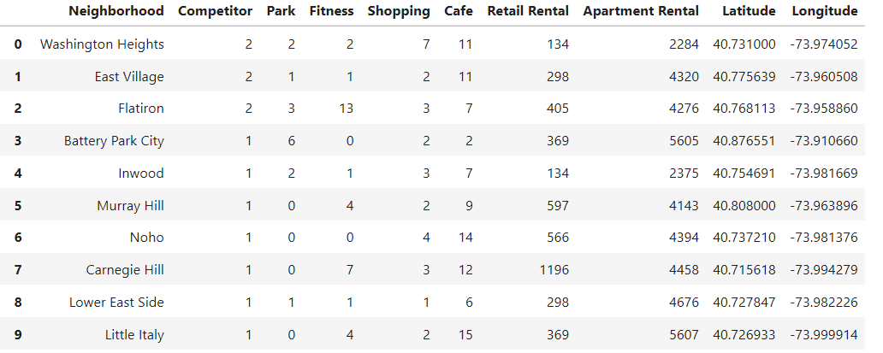
Data Cleaning and Sorting
Group pet store related venues in the same categories and add geographic coordinates
Sort data by pet store “Competitor”(number of existing pet stores)
First 18 neighborhoods have pet store >=1

Slide 6
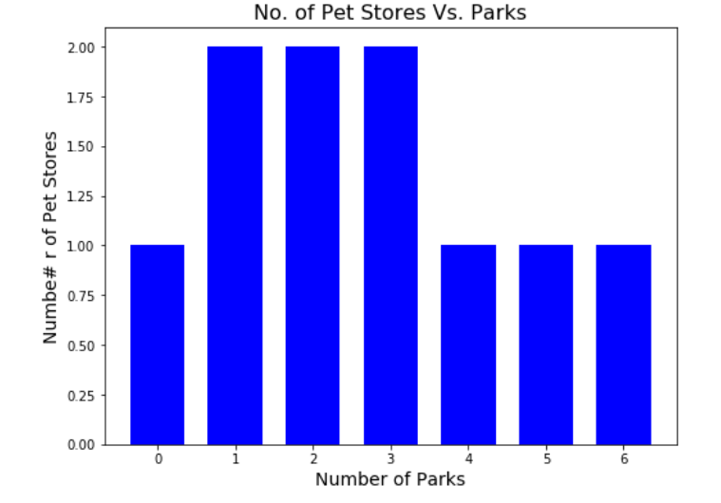
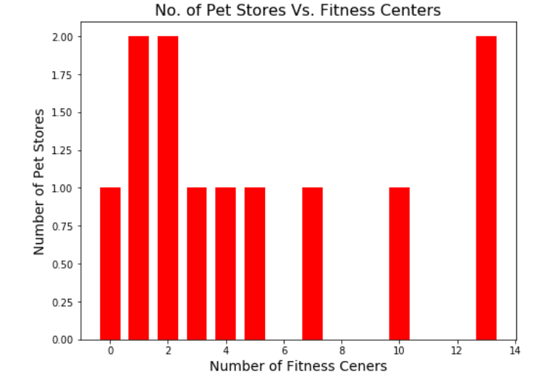
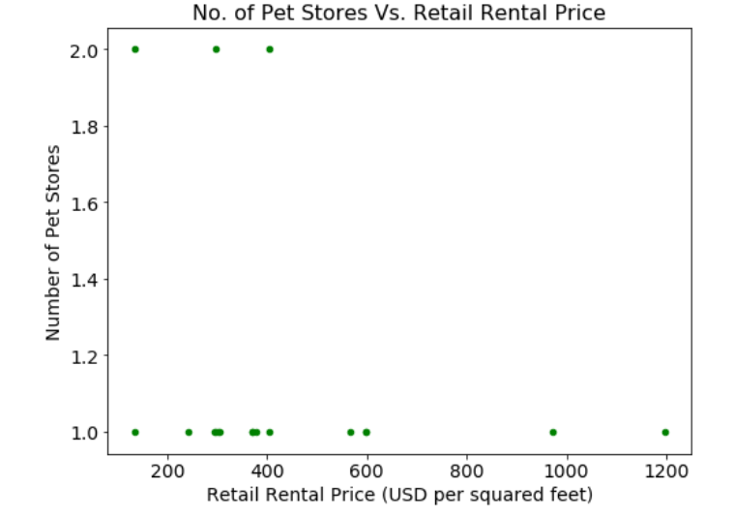
Relationship between Competitor and Other Features
In the first 18 neighborhoods which have pet stores, no simple linear relationship between number of pet stores and other related features.

Slide 7
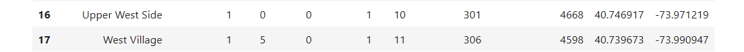
Data Splitting
Training data
First 18 rows
Pet store>=1
:
Y_train
:
X_train
:
Test data
Last 22 rows
Pet store=0
:
:
X_test
:
Y_predict
=?

Slide 8
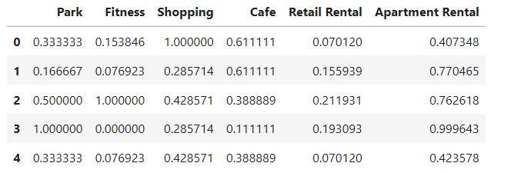
Data Normalization
Normalize x_train and x_test by column max so each feature has similar weight in the model

Slide 9
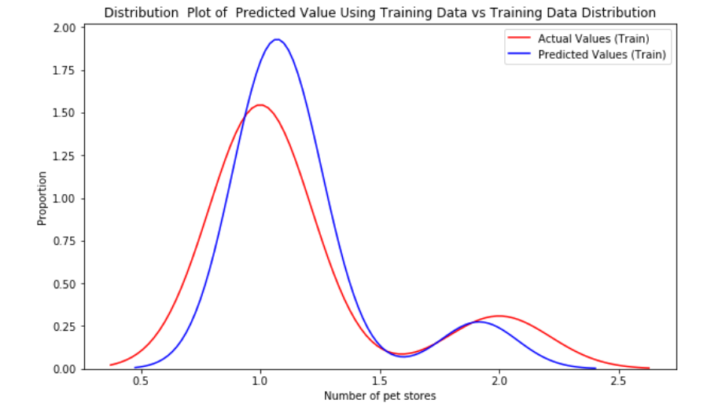
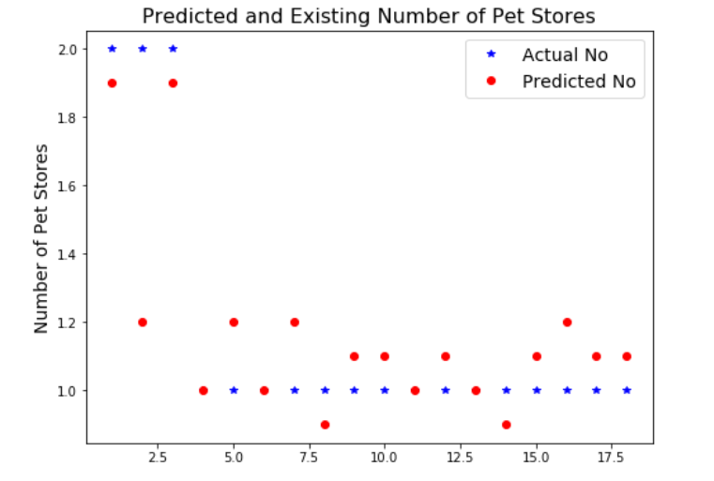
Machine learning
 | R² | Mean Square Error
Multiple Linear Regression | 0.462 | 0.074
Ridge Regression | 0.680 | 0.044
Ridge Regression model
fits training data well

Slide 10
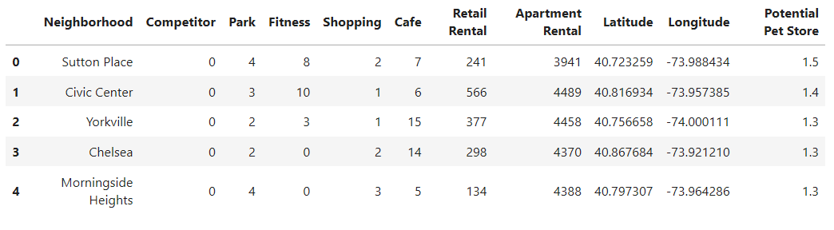
Predict Potential Pet Store Number
Predict number of pet stores using ridge regression on test data
Add predicted number back to data as “Potential Pet Store”
Sort data by “Potential Pet Store” in descending order
Choose top 5 neighborhoods as potential candidates:
Sutton Place, Civic center, Yorkville, Chelsea and Morningside Heights

Slide 11
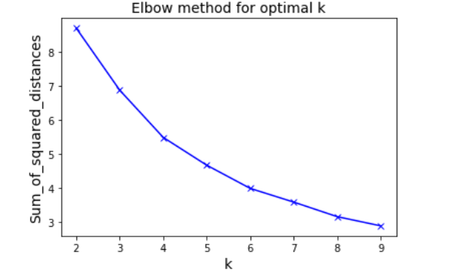
K-means Clustering
6 is the optimal number of clustering

Slide 12
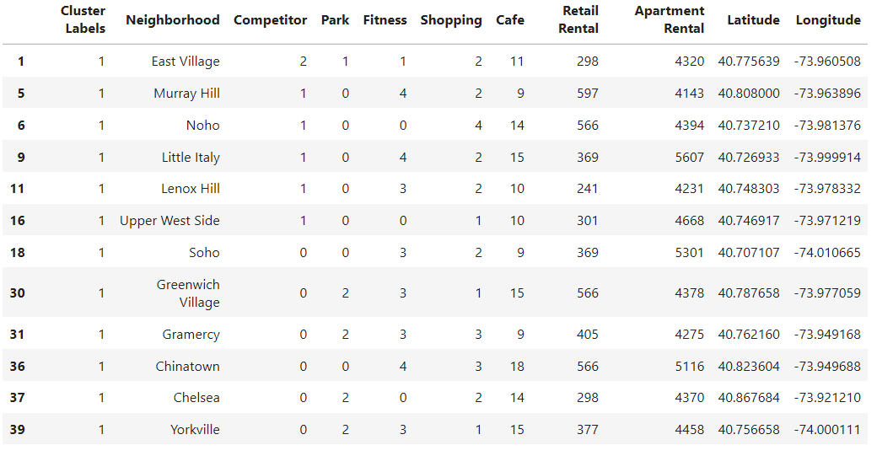
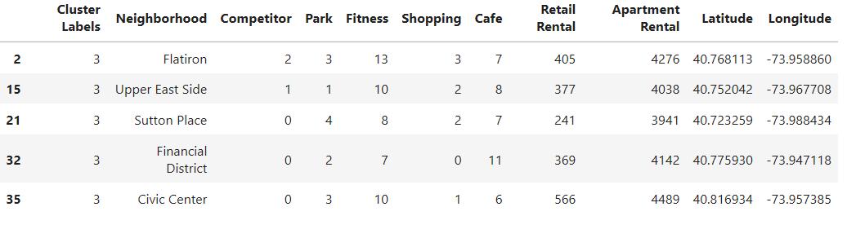
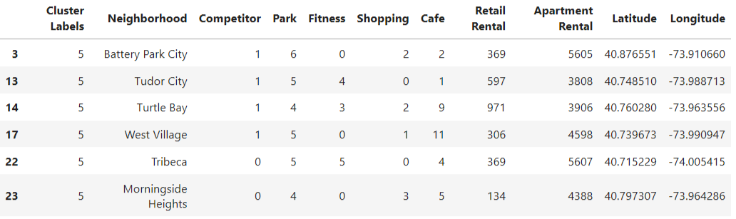
K-means Clustering Results
Cluster 4
Cluster 2
Morningside Heights is the final choice:
4 parks
Low retail rental price
Apartment rental price higher than median
Cluster 6

Slide 13
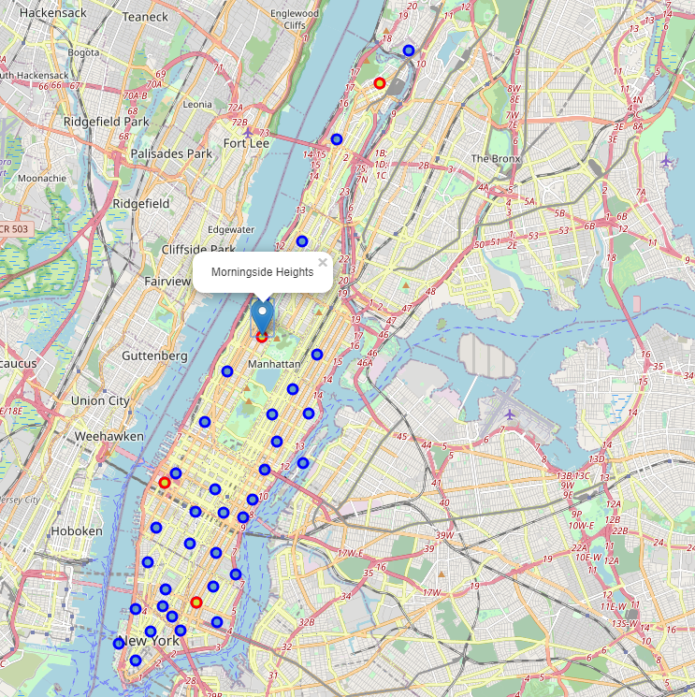
Results Visualization
Morningside Heights is the best neighborhood for opening new pet service store.

Slide 14
Discussion
Mathematic tools are useful but don’t only reply on them
Pick the right features before running K-means clustering
Focus on features which clients really care for decision
making

Slide 15
Conclusion
Introduce Tina’s problem: pick best neighborhood for her
new pet service store
Gathering data related to problem
Analyze data using machine learning and K-means
clustering
Make decision and visualize the result

